Slide 1
HISTORY
CHAPTER 2
THE LIVES OF THE HUNTER-GATHERERS

Slide 2
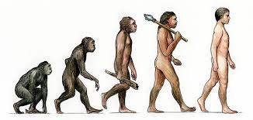
GROUP 1

Slide 3
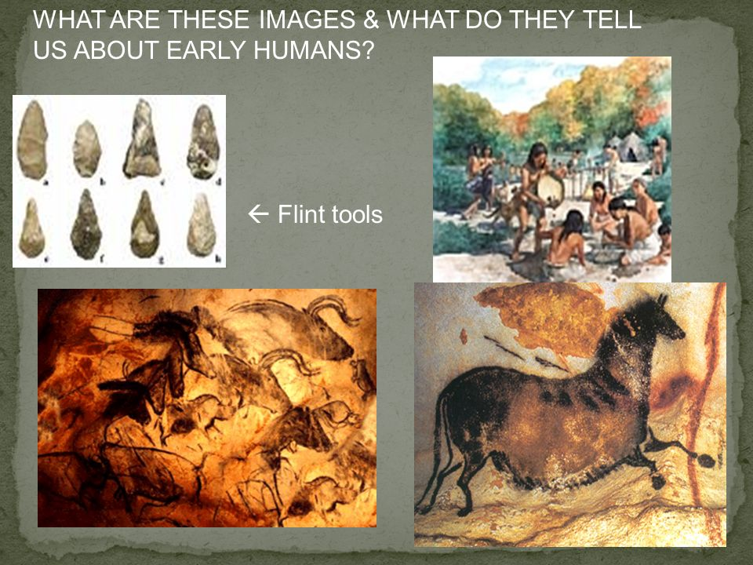
GROUP 2

Slide 4
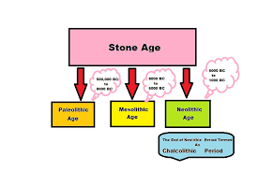
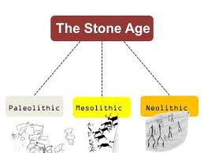
GROUP 3

Slide 5
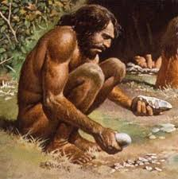
GROUP 4

Slide 6
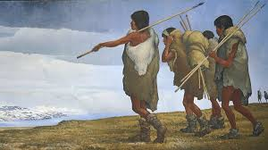
GROUP 5

Slide 7
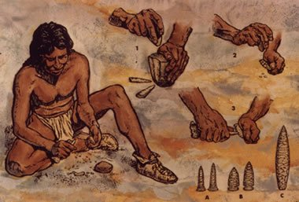
GROUP 6

Slide 8
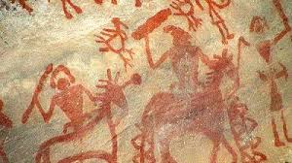
GROUP 7

Slide 9

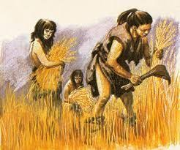
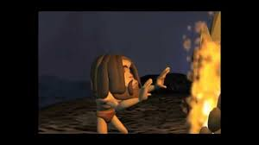
GROUP 8

